Slide 1
Mechanical Advantage
What do simple machines do for us anyway?

Slide 2
There are four ways that a machine helps us to do work.
Transfers our effort force from one place to another. Ex: seesaw
Multiply your effort force. Ex: crowbar
Magnify speed and distance. Ex: baseball bat
Changing the direction of the force. Ex: pulley on the flagpole

Slide 3
Mechanical Advantage
The number of times a machine multiplies your effort force.
Example: If you push on the handle of a car jack with a force of 30 lbs and the jack lifts a 3000 lb car, what is the jack’s mechanical advantage?
The jack multiplies your effort force by 100 times.

Slide 4
There are 2 types of mechanical advantage.
IMA – Ideal mechanical advantage.
This is the number of times a machine is designed to multiply your effort force.
It is based on measurements of the machine.
Ignores friction
AMA – Actual mechanical advantage
This is the number of times the machine actually multiplies your effort force.
AMA = resistance force/effort force.
Includes the effects of friction
IMA is always larger than AMA.

Slide 5
There are 3 Classes of Levers
Depends on the location of 3 items:
1. Fulcrum – fixed point on a lever
2. Effort Arm – the part of the lever that exerts the effort force.
3. Resistance Arm – the part of the lever that exerts the resistance force.
← EA →
←RA→

Slide 6
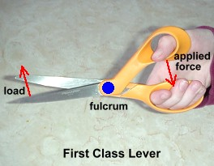
1st Class Lever
Changes the direction of the force
Multiplies effort force
Magnifies speed and distance
Ex: seesaw, crowbar, scissors

Slide 7
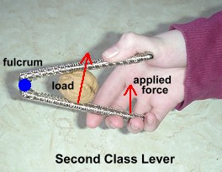
2nd Class Lever
Multiply effort force
Mechanical advantage is always greater than 1.
Ex: bottle opener, boat oars, wheel barrow

Slide 8
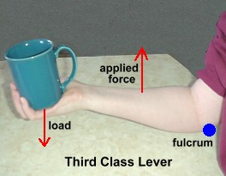
3rd Class Lever
Magnifies speed and distance
Mechanical Advantage always less than 1
Ex: baseball bat, golf club, broom, shovel

Slide 10
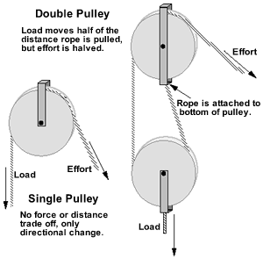

Slide 11
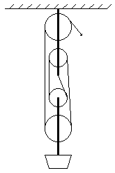
1. What is the IMA of this pulley system? 2. Ignoring friction, if you want to lift the resistance 3 meters what will the effort distance be? 3. Ignoring friction how much effort force will be necessary to lift a load of 15 newtons? 4. How much work is done?

